Slide 1
Live Well San Diego & Data Set
Dale Fleming, Director, Office of Strategy & Innovation, County of San Diego
Ryan Smith, Epidemiologist, County of San Diego
Kathryn Rogers, Communications Manager, Live Well San Diego
March 13, 2015
Notes:
Introductions

Slide 2

ONE VISION
Building Better Health
Living Safely
Thriving
Notes:
Dale
What is Live Well San Diego?
In July of 2010, with the support of the Board of Supervisors, the County of San Diego launched an ambitious, long-term plan to improve the well-being of the entire San Diego region.
As the fifth most populated county in the United States, San Diego County has about 3.2 million residents living in urban, suburban, rural and remote settings covering an area over 4,200 square miles. The county is demographically and geographically diverse.
And like the rest of the United States, San Diego County was dealing with some profound challenges: a growing number of adults and children struggling with chronic disease, and rising healthcare costs.
To put San Diego County on the path to a brighter, healthier future, together we took action and rolled out a strategy, which has now become a broader regional vision, called Live Well San Diego.
From the beginning, it was clear that we needed a strategy to promote better health.
However, as the blueprint for Live Well San Diego took shape, we also realized that it was going to take more than that singular focus to address the issues we were seeing in our region.
As a result, Live Well San Diego has three components, focusing on three major elements of well-being:
…..health, safety, and quality of life—“Building Better Health,” “Living Safely,” and “Thriving,” respectively.

Slide 3

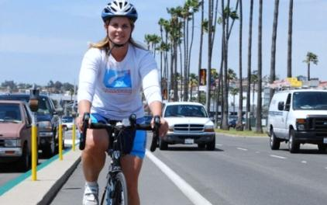
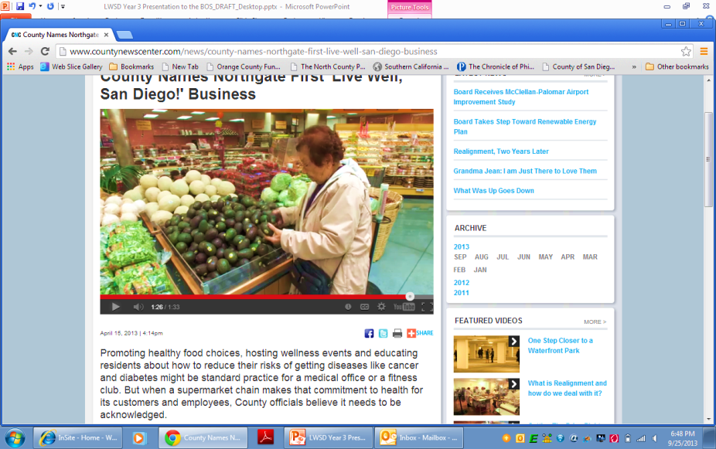
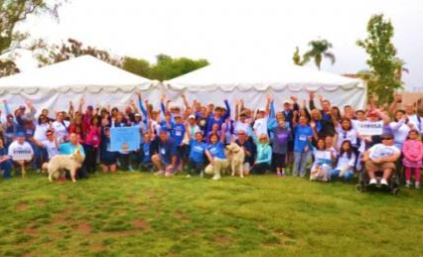
BUILDING BETTER HEALTH
Approved July 2010
Access to quality care
Increased physical activity
Healthy eating
Stop tobacco use
Notes:
Dale
Building Better Health is about breaking down barriers and creating conditions that make it easier for people to live healthy lives. From promoting parks and libraries to creating zones for vegetable gardens to using fire stations to conduct blood pressure checks on Valentine’s Day, we’re transforming the environment San Diegans live in, so all of us may transform ourselves for better health.
But we know wellness means more than just health, so…

Slide 4
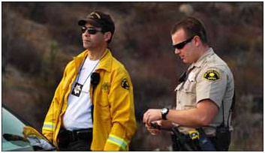
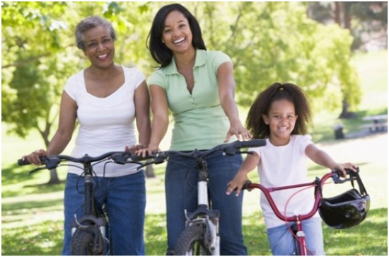
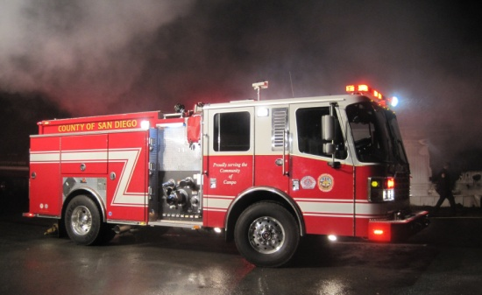
Living safely
Approved October 2012
Residents are protected from crime and abuse
Neighborhoods are safe to live, work and play
Communities are resilient
to disaster and emergencies
Notes:
Dale
The Living Safely strategy is focused on achieving three key outcomes over time, with the fundamental goal of making San Diego County one of the safest regions in the nation.
Our public safety stakeholders work collaboratively to incarcerate criminals through joint task forces and sharing of information. Just as important is targeting at-risk youth with programs and services to prevent them from becoming future criminals. We realize that providing substance abuse treatment, vocational training, housing assistance, and specialized collaborative courts will reduce recidivism and reduce our jail population.
We also realize that aiding the victims of crime is equally important—helping those who were in the wrong place at the wrong time or who were victimized by people they should have been able to trust. Assistance includes finding shelter and transportation, serving as a liaison with hospitals, or protecting vulnerable children and adults from further victimization.
Making neighborhoods safe to live, work, and play is the nexus between health and safety. A perfect example of this is our safe routes to schools efforts, where Public Works departments and law enforcement work with Health and Human Services staff and schools to maintain routes to school that are safe and healthy.
Finally, the upcoming 10 year anniversary of the Cedar Fire, the worst in California’s history, reminds us that we must always be prepared for natural disasters. We’ve come a long way since the 2007 wildfires but there is always room for progress. Ensuring local residents and businesses have 72 hour preparedness is essential for a resilient community. We’ve increased coordination and resource sharing with fire protection districts and the incorporated cities throughout the County.

Slide 5
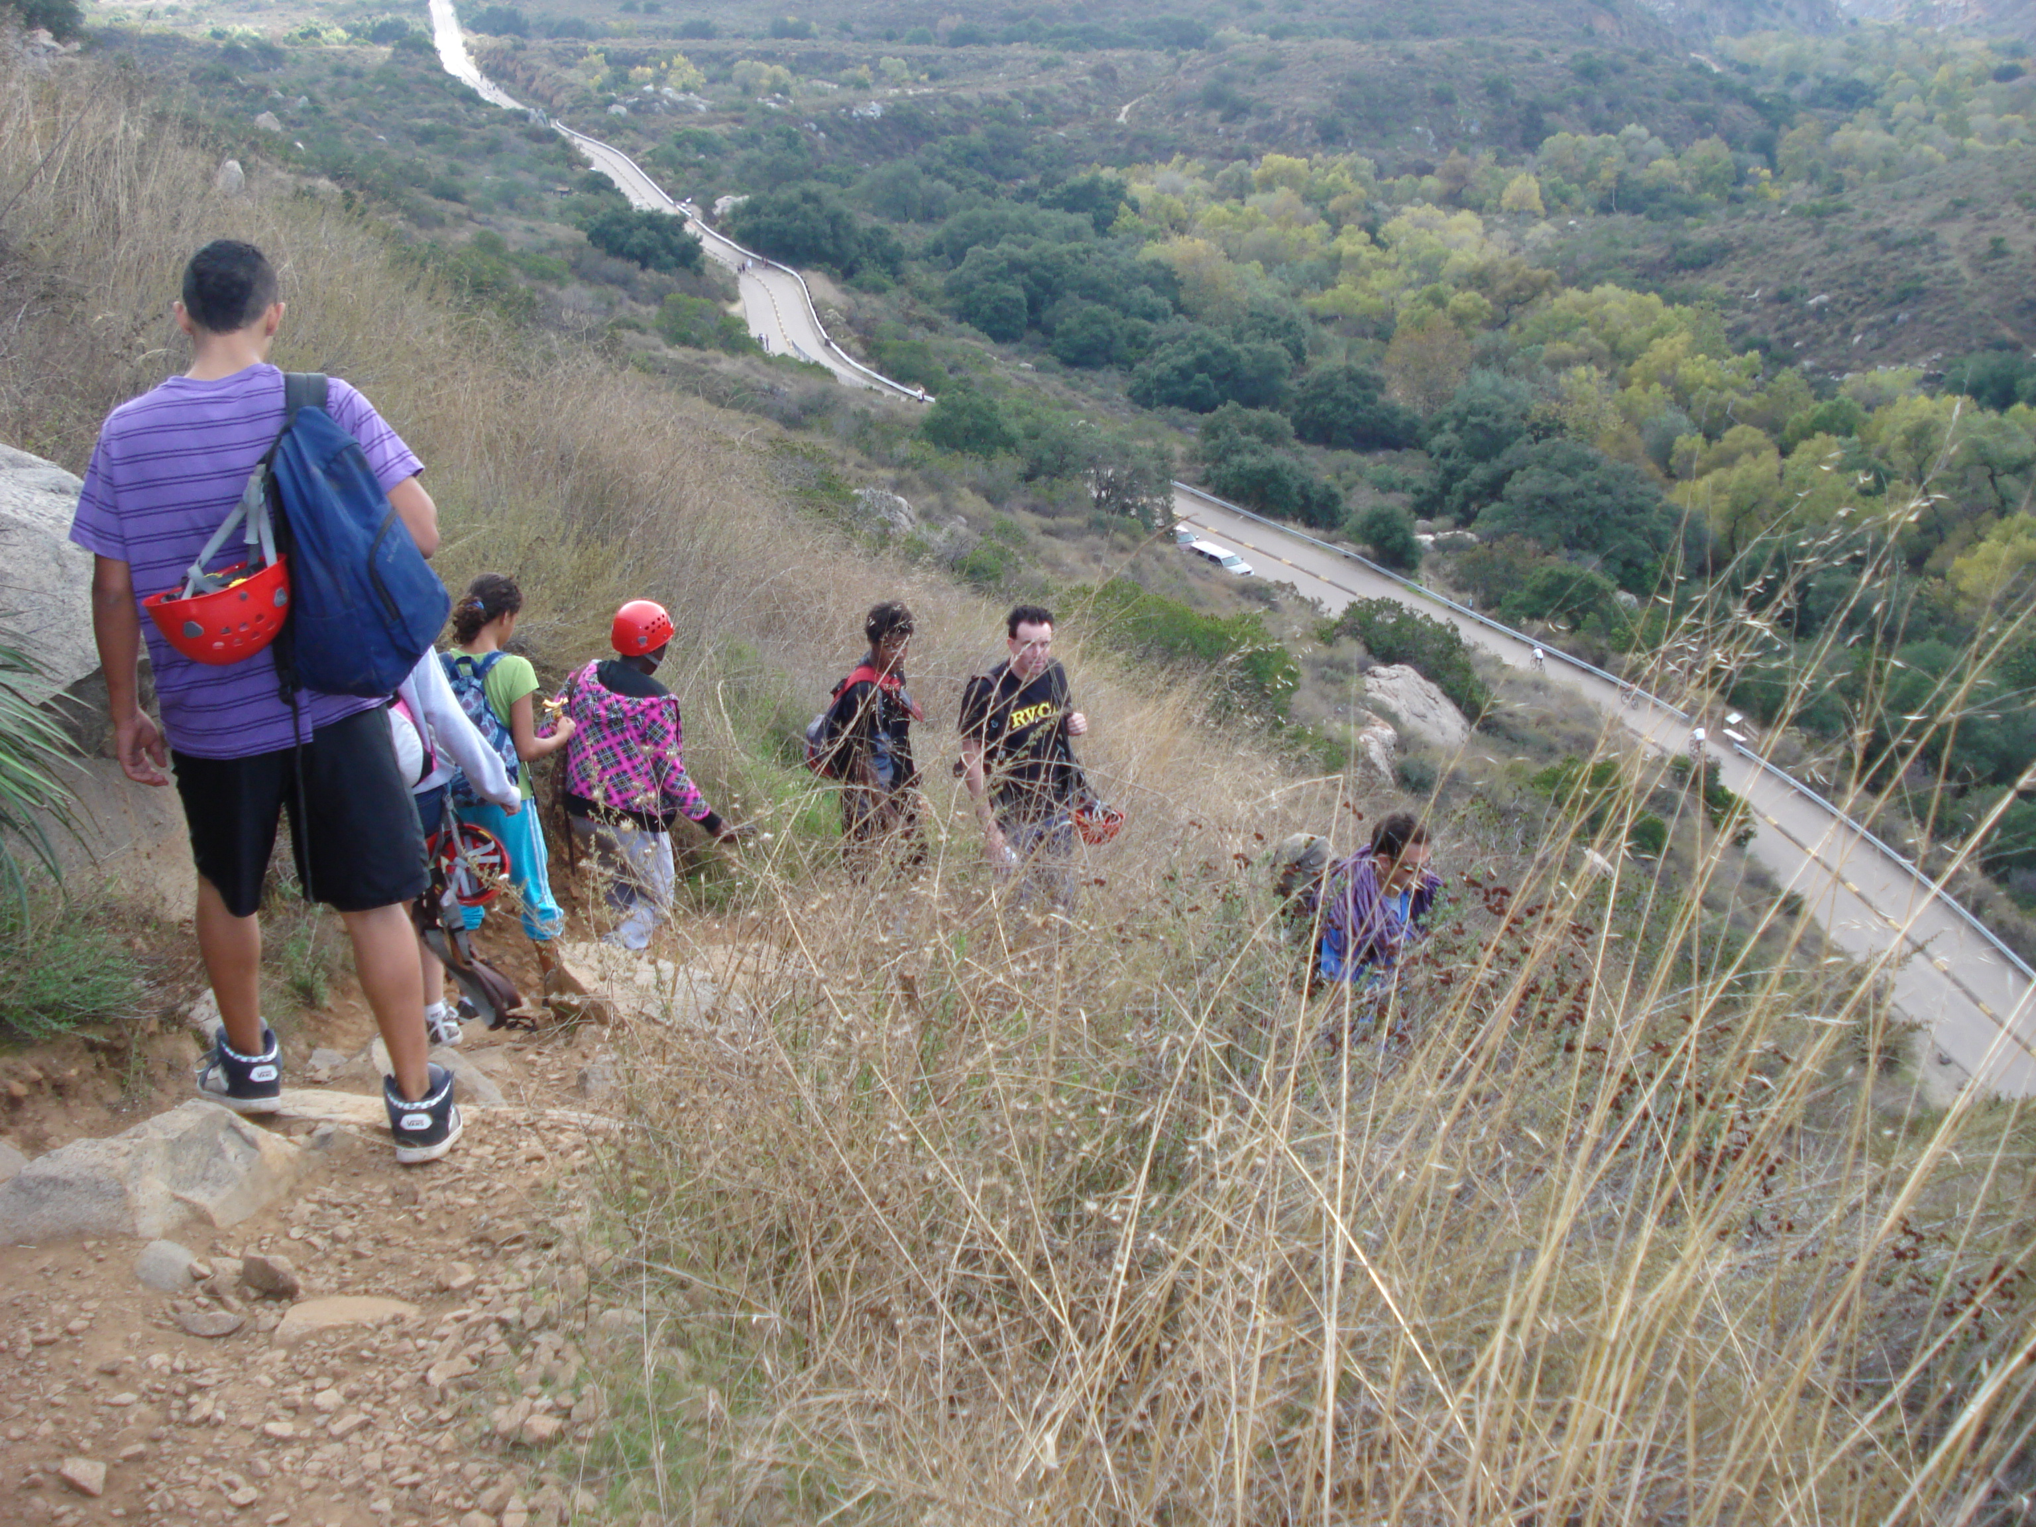
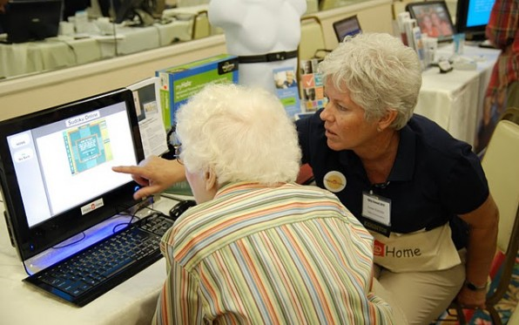
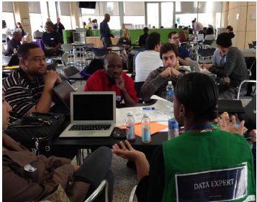
thriving
Approved October 2014
Built and Natural Environment
Transportation
Built Environment & Neighborhoods
Natural Environment
Housing
Enrichment
Civic Life
Community Activities
Prosperity, Economy & Education
Workforce/Education
Economic Development
Notes:
Dale
In 2014, we rolled out the third and final phase of Live Well San Diego, known as “Thriving.”
A dynamic cross-sector group of 70 stakeholders who all have a vested interest in quality-of-life issues in our region were involved in developing the Thriving strategy. These public, private, and nonprofit stakeholders came together as a team to help define “Thriving” because thriving means different things to different people.
These diverse representatives included local business and education, healthcare, philanthropy and community services, government, environment, military, arts and culture, and the faith communities. The goal was to identify opportunities where, by working together, we will be able to achieve greater results in improving our region's quality of life.
Thriving’s collective vision is “Cultivating opportunities for all people and communities to grow, connect, and enjoy the highest quality of life.”
The themes of “Engaging,” “Connecting” and “Flourishing” provide the lens we looked through to make sure we were striving to thrive… really doing something that will make a difference in the lives of our residents.
The focus areas evolved out of the priorities our community partners helped identify – Built and Natural Environment; Enrichment; and Prosperity, Economy and Education.
Specific goal areas, strategies and actions were developed that support each of the priority areas.
In the focus area of Built and Natural Environment, transportation and housing came up in nearly every group and team we met with. Broadening transportation options to improve accessibility between destinations is one of the keys to help our residents be connected to each other and to the services they need. One example of this connection is looking at where libraries, parks and social services are located in relationship to transportation and homes.
Our community stakeholders universally noted that being involved in the community, whether it’s through volunteering, voting, or voicing their opinion, was an integral part of a Thriving region – framing the Enrichment focus area. We’ll be working with our external partners and internal departments on a variety of activities that help improve the impact of volunteerism, expand the use of civic spaces, and advance the arts, culture and creative community.
Our community stakeholders also highlighted the importance of education and workforce development for communities to prosper and economies to flourish – laying the foundations for the Prosperity, Economy and Education focus area. For this reason, a key strategy is to expand partnerships to provide education and training opportunities to develop the workforce that is needed for today’s and tomorrow’s jobs.

Slide 6
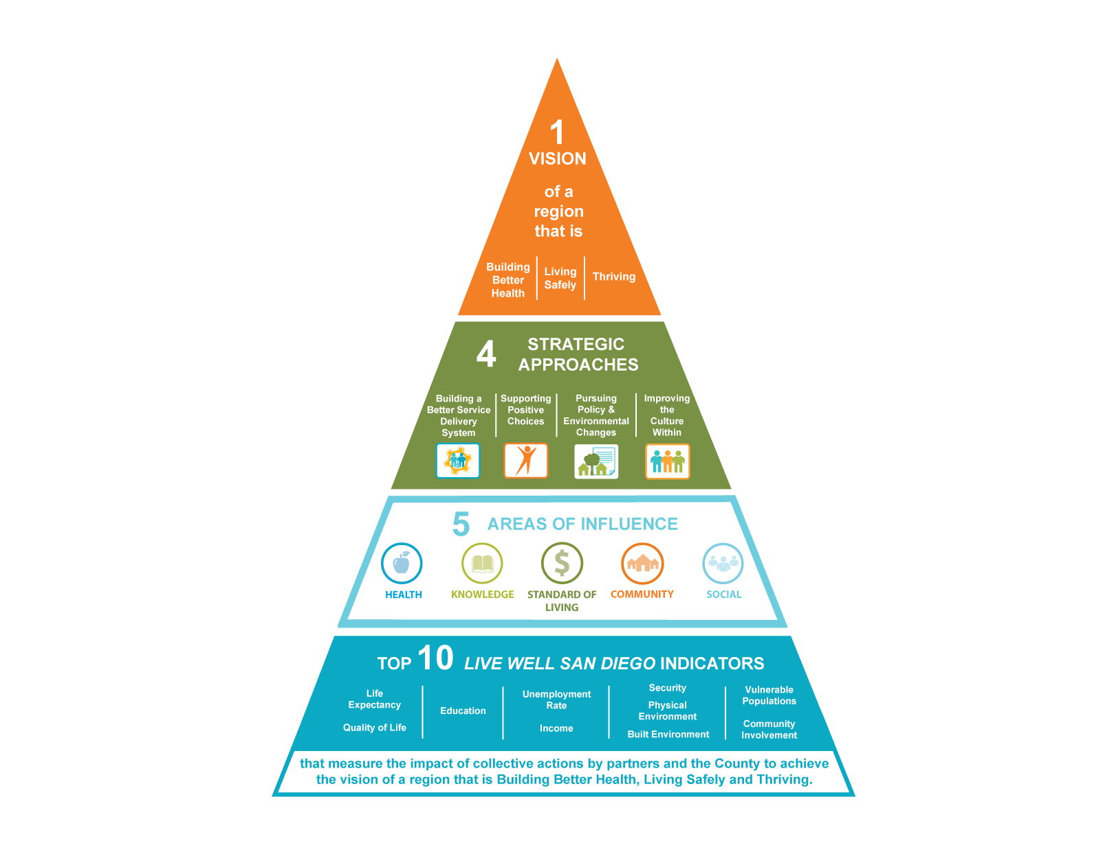
Comprehensive approach
Notes:
Dale
Live Well San Diego is 1 Vision; 3 Components—Building Better Health, Living Safely and Thriving; 4 Strategies; and progress is measured across 5 Areas of Influence and 10 Indicators. This is a comprehensive approach.

Slide 7

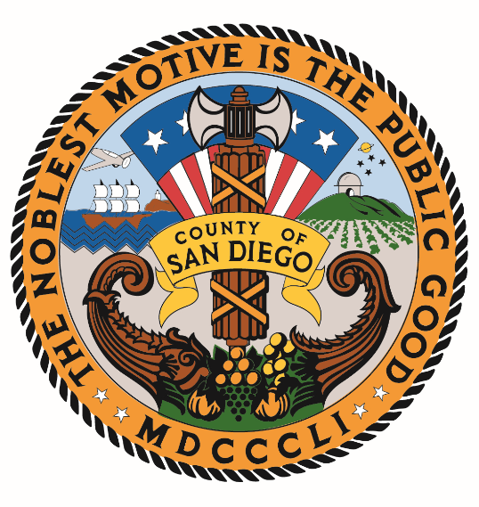




WORKING ACROSS SECTORS
Aligning strategies across all sectors
Notes:
Dale
To achieve the Live Well San Diego vision of a healthy, safe and thriving San Diego County, we are aligning strategies across all sectors: county government, cities, businesses, schools and non-profit organizations which include community and faith based organizations.

Slide 8
Recognized partners by Fiscal Year and Sector
175
Recognized Partners
as of 3/11/16
12 Cities – More than 2.2 million Residents
29 School Districts – Over 376,701
Students
Notes:
DALE
175 recognized partners as of March 11, 2016.
29 school districts with over 376,701 Students
12 Cities with more than 2.2 million residents (SANDAG Population Estimates 2014)
Exceeded County Goal: 132 total by October 2015
Partners are identified by Department Executives and/or General Managers
The success of Live Well San Diego has resulted in higher demand for information on becoming a recognized partner. We’re exploring technology solutions used by other local governments which will help us meet that demand, onboard an increasing number of partners, and maintain relationships with partners in the future.

Slide 9





Collective Action to Community Impact
Actions We Take Collectively Across Sectors
County & City Governments
Business
Community & Faith-Based Organizations
Results We Seek
for Community Impact
Schools
Healthcare & Technology Providers
Law Enforcement & Courts
Active Military/Veterans
Other Local Jurisdictions
Notes:
Dale
Live Well San Diego is a collective impact strategy. Achieving a healthy, safe and thriving San Diego County involves everyone working together towards the same vision.
In simplest terms:
We can do more together than we could ever do alone
We can do different things (things each of us is best at) while contributing to the same positive change
We can structure how we do things to draw from research and best practices, leverage each other’s efforts, and measure our individual contributions as well as our cumulative impact
That’s why our model of change is one in which everyone does what they do best with the goal of impacting the five Areas of Influence and, consequently, achieving the results we seek as captured through the 5 Areas of Influence.

Slide 10
MEASURING RESULTS
Areas of Influence | Definition | Top 10 Indicators
 | Enjoying good health and expecting to live a full life | Life Expectancy Quality of Life
 | Learning throughout the lifespan | Education
 | Having enough resources for a quality life | Unemployment Rate Income
 | Living in a clean and safe neighborhood | Security Physical Environment Built Environment
 | Helping each other to live well | Vulnerable Population Community Involvement
Notes:
Dale
To watch our progress, we have identified the Top 10 Indicators that span five Areas of Influence—Health, Knowledge, Standard of Living, Community and Social—that will track progress toward our one vision of a healthy, safe and thriving county.
These Top 10 Indicators were identified with the help of our citizen advisory boards, community stakeholders and national, state and local data experts, and were selected because:
They are easy to understand
The data are available to compare our progress to other communities, the state and nation
The data capture well-being across the life span of an individual, from children to older adults, and are available by gender, by race/ethnicity and by community, which will guide and support planning for action.
The Top 10 Indicators are: Life Expectancy, Quality of Life, Knowledge, Unemployment Rate, Income, Security, Physical Environment, Built Environment, Vulnerable Populations, and Community Involvement. See Areas of Influence and Top 10 Indicators document within General Information attachment.

Slide 11
3-4-50 FRAMEWORK
Understanding the impact of chronic disease in San Diego County
Notes:
Ryan

Slide 12
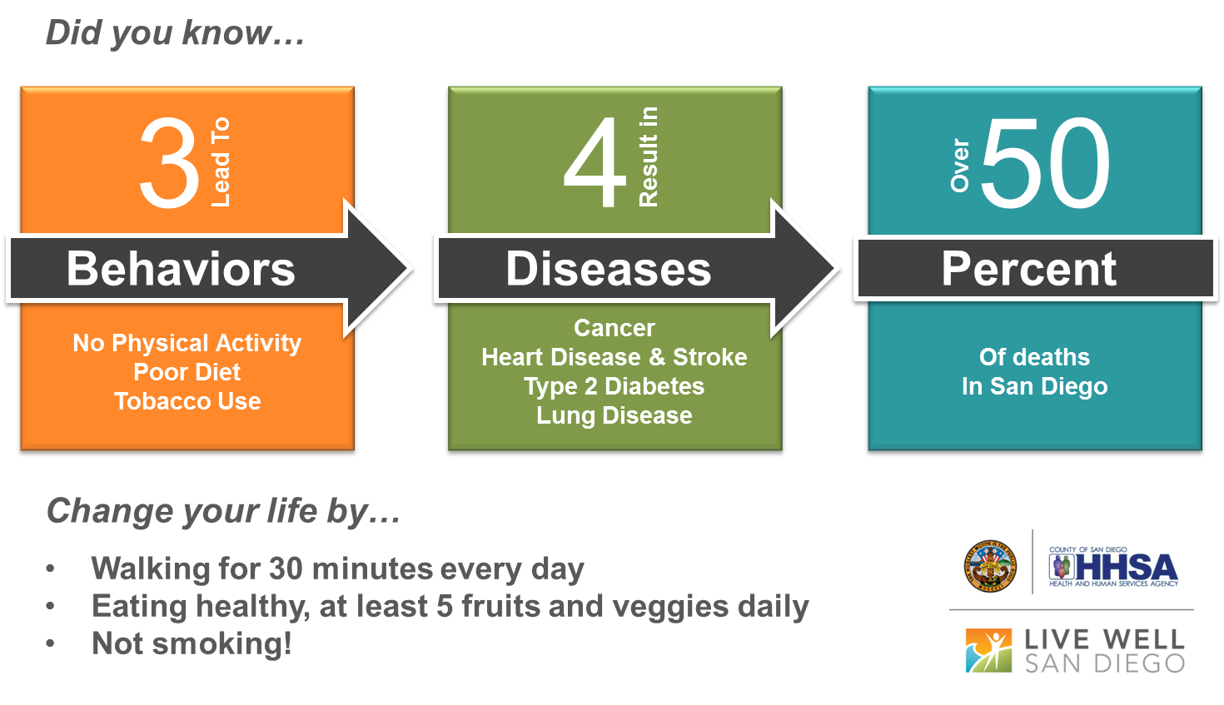
3-4-50 FRAMEWORK
Notes:
Ryan
Operation 3-4-50
Alright everyone, your mission, which you have clearly chosen if you are sitting in this room, is to help us identify how to address our main preventable disease deaths in San Diego County. This is the 3-4-50 concept, but by the lenses of health equity.

Slide 13

3-4-50 in a nutshell
Chronic diseases are now the major cause of death and disability worldwide.
In San Diego County in 2007, the 3‐4‐50 diseases caused 57 percent of deaths and cost $4 billion in direct treatment expenditures.
Notes:
Ryan

Slide 14
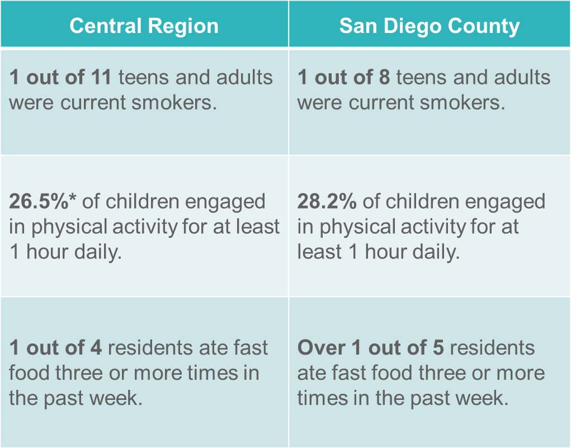
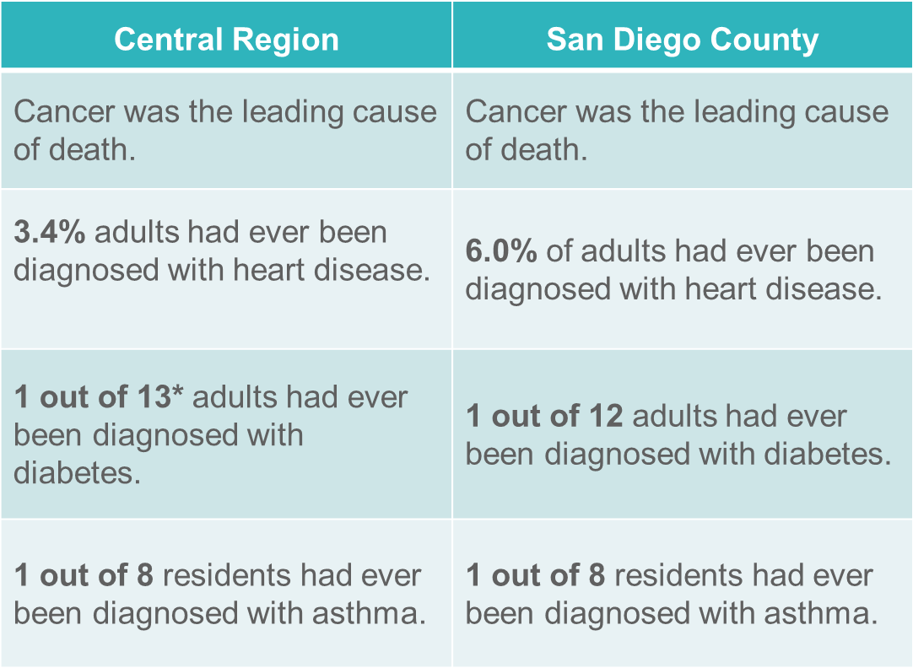
3 Behaviors/4 Diseases
Smoking
Cancer
Heart Disease
& Stroke
Lack of Physical Activity
Diabetes
Diet
Lung Disease
Source: UCLA Center for Health Policy Research, California Health Interview Survey (CHIS), 2013.
Notes:
Ryan

Slide 15
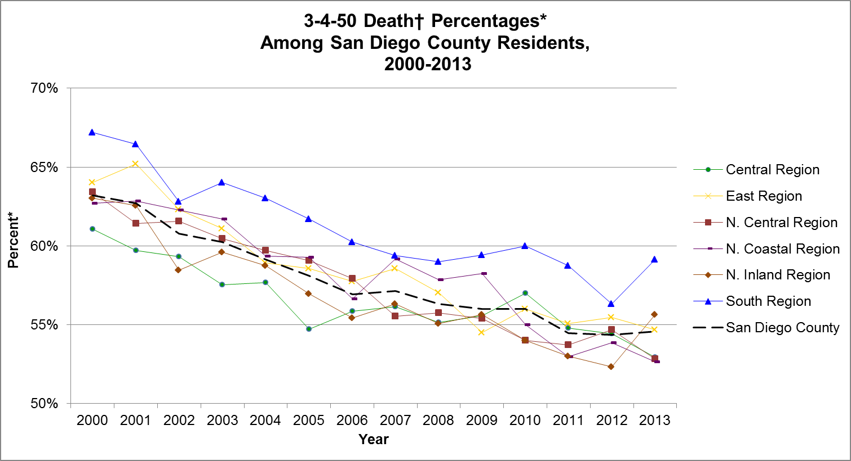
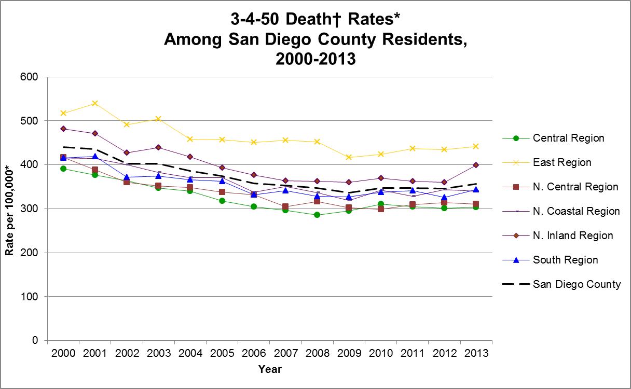
3-4-50 in San Diego County
From 2000 to 2013:
The percent of all deaths due to 3-4-50 chronic diseases has decreased in the County and the Regions, while the number of deaths have remained relatively stable.
Current 3-4-50 Chronic Disease Number: 55%
Notes:
Ryan

Slide 16
Health Outcomes by lenses of health equity
San Diego County Data
Notes:
Ryan

Slide 17
QUALITY OF HEALTH,
DIFFERENCES AND DISPARITIES
Social circumstances
Difference
Environmental exposures
= Disparity
Behavioral patterns
Group 1
Health care
Quality of Health
Group 2
Genetic predisposition
Adapted from Gomes and McGuire, 2001
Notes:
Ryan
Health equity is a key component of the Live Well San Diego vision in San Diego County. Addressing health disparities is essential in increasing and ultimately achieving health equity. The health of most Americans has improved in the past century, however some groups continue to experience a disproportionately higher burden of morbidity and mortality. Nationally, there are significant differences in rates of disease, death, and lifestyle behaviors. These differences, or health disparities, exist between genders, among racial/ethnic and age groups, geographic location, socioeconomic status, disability, and sexual orientation.
Not everyone gets sick, and not everyone becomes sick from the same things. Some groups of people are disproportionately affected by diseases and disorders and its our job to figure out why and how to prevent that.

Slide 18
QUALITY OF HEALTH,
DIFFERENCES AND DISPARITIES
Reason for differences
Source of information
Social circumstances
Education, income, housing, employment
Genetic predisposition
Familial diseases,
Behavioral patterns
Lifestyle, exercise
Lifestyle, exercise
Health Indicators
Access, insurance, hospitalizations,
quality of care
Access, insurance, hospitalizations,
quality of care
Health care
Environmental Exposures
Tobacco smoke,
lead exposure,
Air quality
Notes:
Ryan
We try to track the reasons and causes of those health disparities and join that our health data to help tell a more meaningful story. Which is exactly what you all will be doing.

Slide 19
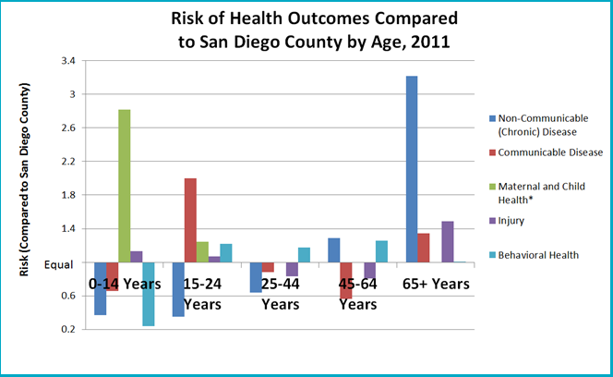
Health Equity by Age
Notes:
Ryan
There are a number of lenses of health equity, but we can’t really track sexual orientation or disability status too well at this point in time. In a few years, that may be a bit more easy, but in the meantime, we look at these lenses: age, gender, geography, race/ethnicity, SES- income.
In 2011, age disparities in San Diego County varied greatly. Compared to the county, residents 45 years and older had higher rates of non-communicable (chronic) diseases while those under the age of 24 had higher rates of poor maternal and child health related outcomes. Residents 15 -24 years of age and over 65 years old had higher rates of communicable diseases.

Slide 20
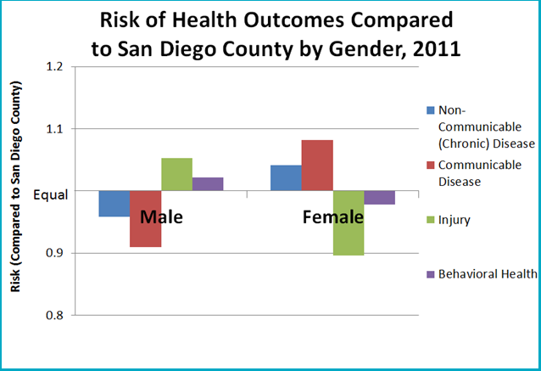
Health Equity by Gender
Notes:
Ryan
In 2011, females had higher rates of non-communicable (chronic) diseases and reported communicable diseases compared to the county, where men had higher rates of injuries and poor behavioral health outcomes.

Slide 21
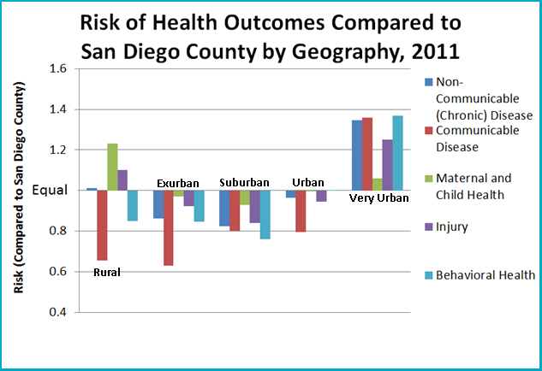
Health Equity by Geography
Notes:
Ryan
In 2011, residents living in very urban environments had higher rates of all health outcomes compared to the county. Additionally, those who lived in rural environments had higher rates of poor maternal and child health outcomes, injuries, and non-communicable (chronic) diseases. Urbanicity categories are determined by average population density per square mile.

Slide 22
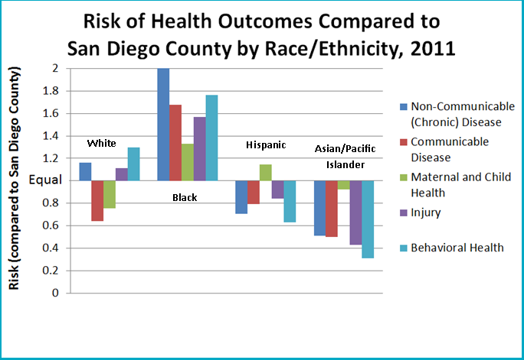
Health Equity by Race/Ethnicity
Source: Death Statistical Master Files (CDPH), Patient Discharge Data (CA OSHPD), Emergency Department Data (CA OSHPD); HIV/AIDS Reporting System and STD Morbidity Database (CoSD HIV, STD and Hepatitis Branch), County of San Diego, Health & Human Services Agency, Epidemiology & Immunization Services Branch, Emergency Medical Services Branch, HIV, STD, and Hepatitis Branch; SANDAG, Current Population Estimates, 10/2012.
Prepared by County of San Diego (CoSD), Health & Human Services Agency (HHSA), Community Health Statistics Unit, 2013.
Notes:
Ryan
In 2011, black residents had higher rates of all health outcomes compared to the rest of the county, while Asian/ Pacific Islander residents had lower rates of all health outcomes.

Slide 23
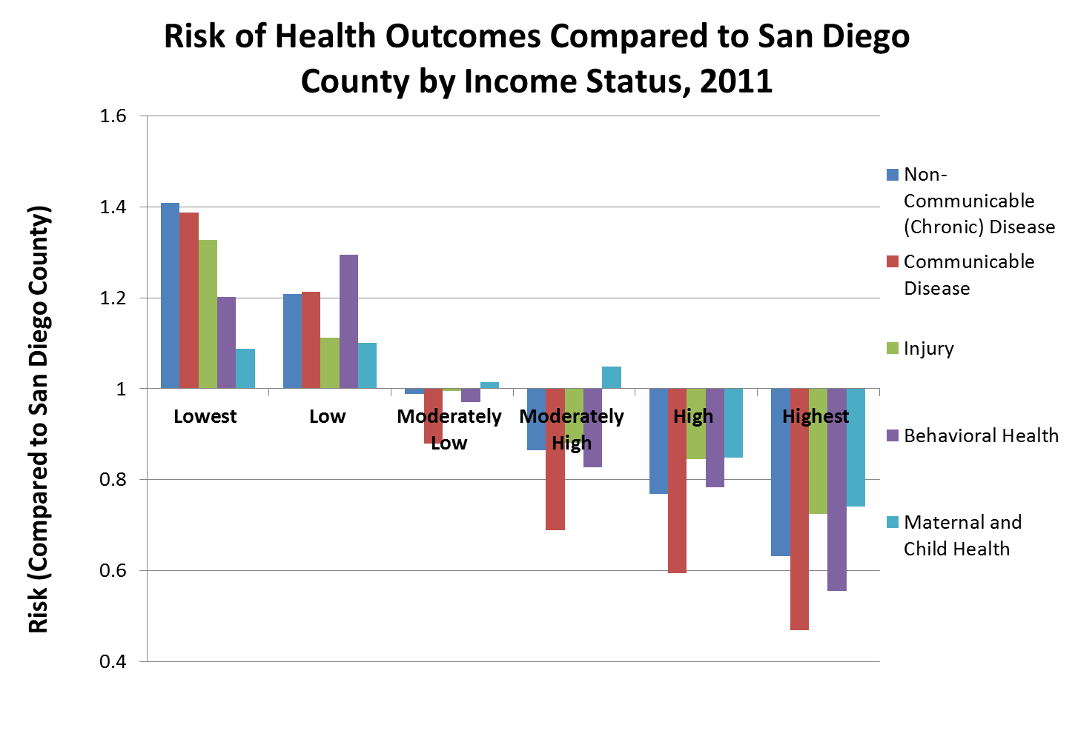
Health Equity by SES (Income)
Equal
Notes:
Ryan
In 2011, residents with the lowest and low incomes had the highest rates of all health outcomes compared to the rest of the county, while residents with higher incomes had lower rates of all health outcomes. Socioeconomic Status is measured by median household income (as determined by the American Community Survey) as a proxy: lowest ($40,000-$50,000), low ($50,000-$60,000), moderately low ($60,000-$70,000), moderately high ($70,000-$80,000), high ($80,000-$90,000) and highest incomes ($90,000+).

Slide 24


Your Mission, Should you choose to accept it…
Operation 3-4-50
Question 1: What’s the Situation?
What are the strongest trends across economics, disease and behavior data when broken out by the under-served population sub-groups identified in the 5 health equity lenses: socio-economic status; age, gender, race/ethnicity & geography (using population density as the measure)?
Where do we see the highest rates?
Who is more likely to have higher rates?
What behaviors, demographic and economic trends do we see in the same communities and groups?
Notes:
Ryan
So let’s dive into the Questions and the Data Set!
Say Q1.
This says to me: What’s the situation?
-3 Qs
Paint the picture. What’s the setting? And from this, what is your hypothesis? WHAT could be driving factors related to our disease trends? Set the stage.
This is probably going to be basic descriptives, methodologically speaking. You have complete freedom to get as creative as you want with this.

Slide 25
Your Mission, Should you choose to accept it…
Operation 3-4-50
Question 2: What is the Next Step?
Looking at the data, can you identify any protective behaviors that may reduce the rates of the 4 diseases (cancer, heart disease, lung disease, diabetes) in under-served communities highlighted by the 5 lenses of health equity: socio-economic status, age, gender, race/ethnicity, & geography (using population density as the measure)?
What behaviors or other factors might be related or associated to these diseases?
Of these variables, what might reduce our rates of chronic disease medical encounters?
Notes:
Ryan
Say Q2-
This says to me: alright, whats the next step? We know the situation, now what?!
2 Qs
Time to test WHAT could be driving factors related to our disease trends! What is associated and what might be protective?
Again, you should keep creative with this but methodologically speaking, I see correlations here, maybe some predictive analytics, but mostly correlations. What’s positively associated and what is negatively associated with our diseases?

Slide 26
Your Mission, Should you choose to accept it…
Operation 3-4-50
Question 3: Predict what will happen.
Option 1
“What is the projected disease rate in the next 10 years for 1 of the 4 chronic 3-4-50 diseases (cancer, heart disease, lung disease, diabetes) in under-served communities by the 5 lenses health equity: socio-economic status, age, gender, race/ethnicity & geography (using population density as the measure)?
What are the projected disease rates in the same communities in the next 10 years if the protective behaviors identified in Q2 are adopted?”
Notes:
Ryan
Ok Q3 has 2 options: you must pick 1. And for each of these, there are actually 2 parts. This is where it gets tricky.
This Question ultimately says to me: Predict what will happen.
Say Q3
It’s a long question but ultimately we want to know if your associations could make a change or a real difference. Project out what we would expect our rates of disease to be in 10 years. Now say, Perhaps you find that those who visit fast food restaurants often in a certain area have higher rates of disease. If you can tell me that by addressing that behavior, the rates potentially could lower in 10 years, then that is something meaningful to us. That gives us something potentially actionable for us as we work on interventions.
For this you can do a lot of different methods. I can see a Cluster Analysis, Factor Analysis, several different regressions. Its up to you. Ultimately we are looking to see if you can help us find a way to make a difference.

Slide 27
Your Mission, Should you choose to accept it…
Operation 3-4-50
Question 3: Predict what will happen.
Option 2
“What is the projected disease rate in the next 10 years for the 4 chronic 3-4-50 diseases (cancer, heart disease, lung disease, diabetes) in under-served communities by 1 of the 5 lenses health equity: socio-economic status, age, gender, race/ethnicity & geography (using population density as the measure)?
What are the projected disease rates in the same communities in the next 10 years if the protective behaviors identified in Q2 are adopted?”
Notes:
Ryan
Ok Q3 has 2 options: you must pick 1. And for each of these, there are actually 2 parts. This is where it gets tricky.
This Question ultimately says to me: Predict what will happen.
Say Q3
It’s a long question but ultimately we want to know if your associations could make a change or a real difference. Project out what we would expect our rates of disease to be in 10 years. Now say, Perhaps you find that those who visit fast food restaurants often in a certain area have higher rates of disease. If you can tell me that by addressing that behavior, the rates potentially could lower in 10 years, then that is something meaningful to us. That gives us something potentially actionable for us as we work on interventions.
For this you can do a lot of different methods. I can see a Cluster Analysis, Factor Analysis, several different regressions. Its up to you. Ultimately we are looking to see if you can help us find a way to make a difference.

Slide 28
The Data Packets
Taking raw data and turning it into something meaningful
Notes:
Ryan
Open up data files

Slide 29
Additional Resources
Notes:
Ryan

Slide 30
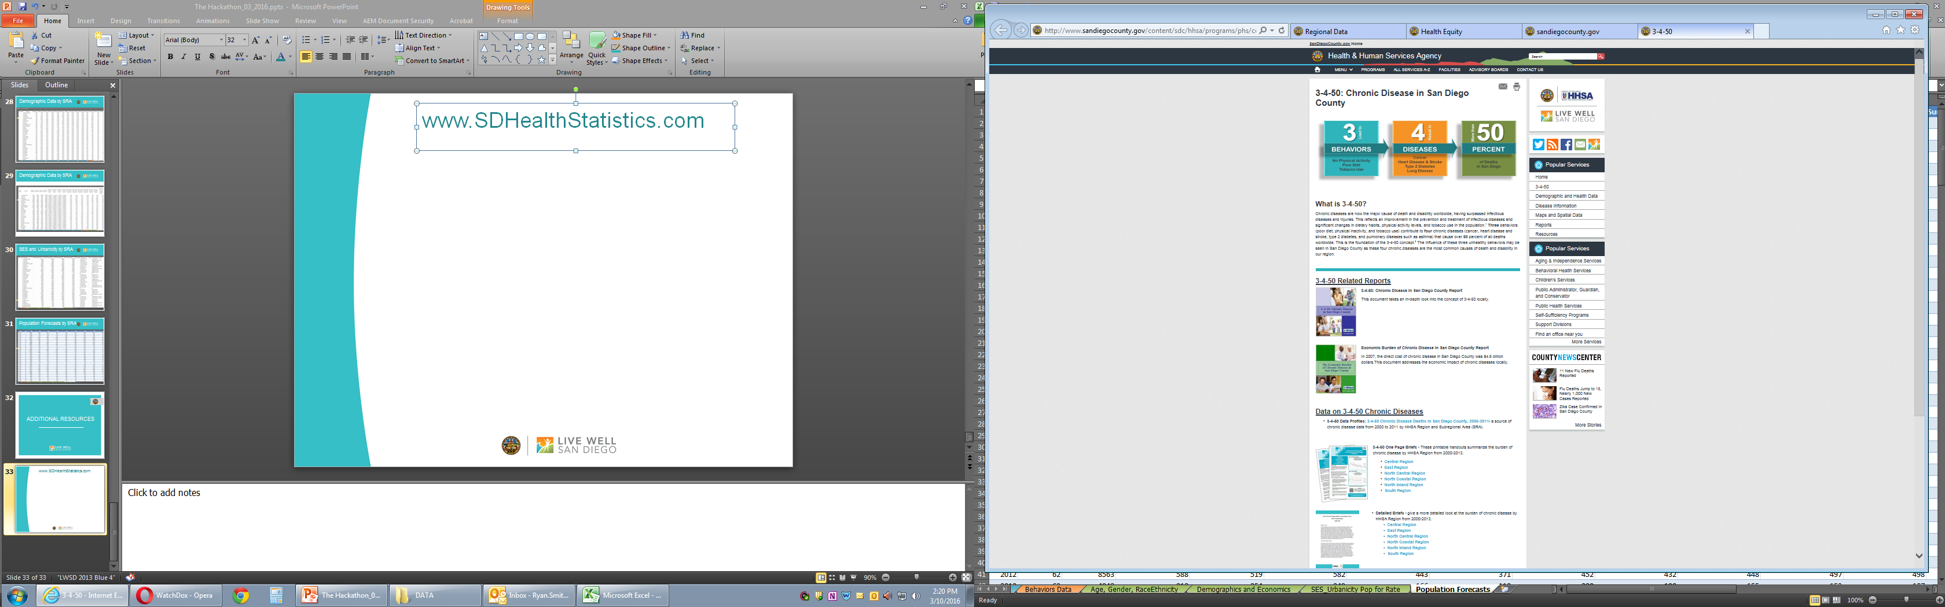
SDHealthStatistics.com
Notes:
Ryan

Slide 31
BRANDING
WHAT MAKES A STRONG PRESENTATION?
Simplicity
Explain the what, why and impact
Relevance
Strong data presentations align with the needs of the community they are about
Consistency
The branding should match Live Well San Diego
Notes:
Kathryn

Slide 32
WatchDOX
Secured file-sharing platform where each contest participant can download the data set and supporting documents, and upload your final submissions
Permission granted via email address
Data set will expire following the contest submission deadline
Notes:
Kathryn

Slide 33
Questions?

